Slide 1
PBCST304 Object Oriented Programming
Module 4 (Part 1)
Prepared by
Renetha J.B.

Slide 2
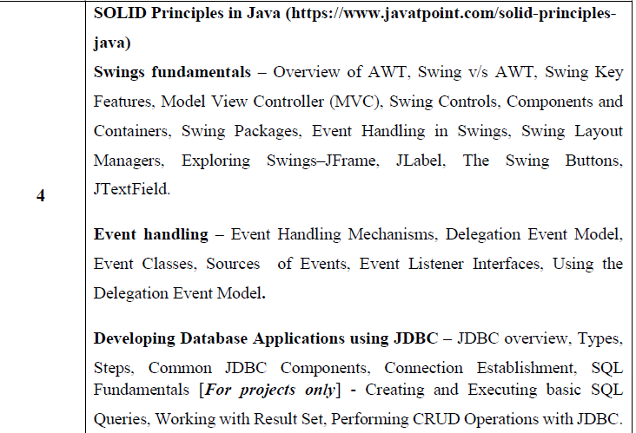
Module 4 syllabus

Slide 3
Topics
Swings fundamentals
Overview of AWT,
Swing v/s AWT,
Swing Key Features,

Slide 4
Overview of AWT
AWT- Abstract Window Toolkit
AWT contains numerous classes and methods to create and manage Windows.
AWT classes are contained in java.awt package

Slide 5
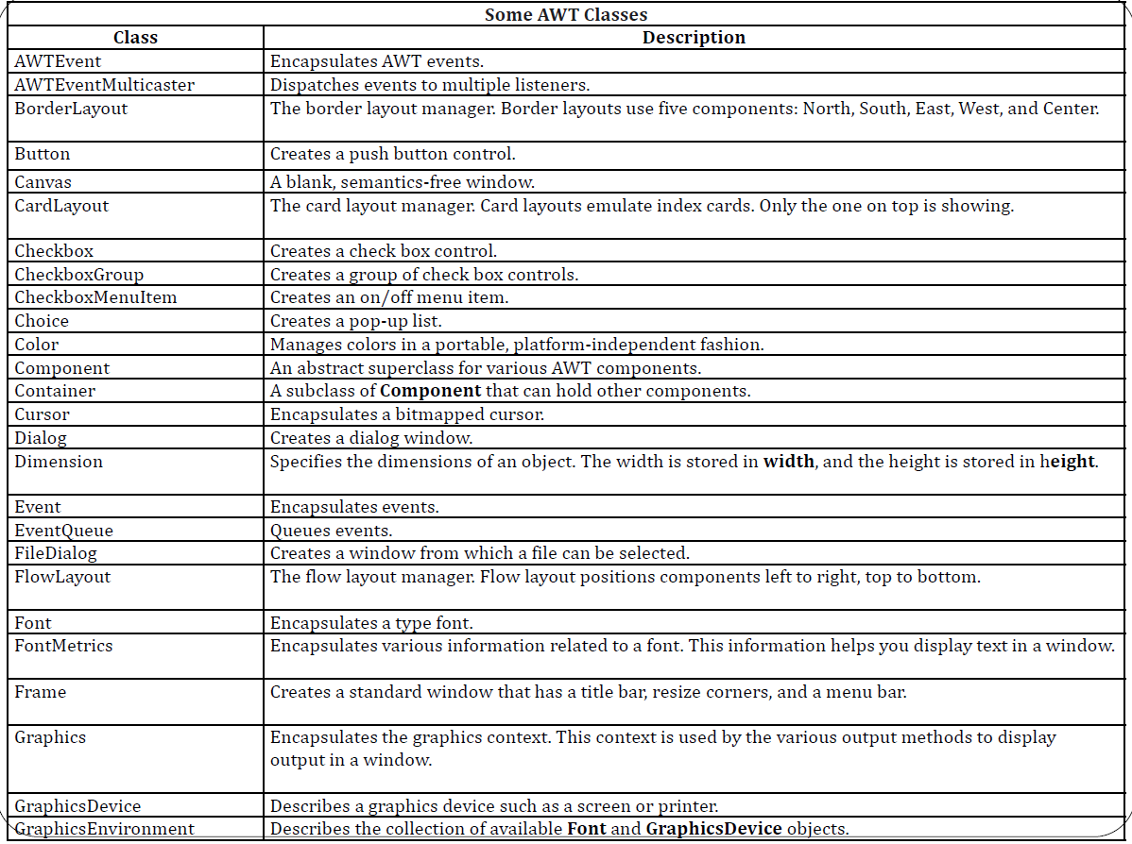

Slide 6
Window Fundamentals
The AWT defines windows according to a class hierarchy.
  At the top of the AWT hierarchy is the Component class(abstract class)
    The Container class is a subclass of Component.
      The Panel class is a concrete subclass of Container
        (Panel is a window that does not contain a title bar, menu bar, or border.
      Window class is a subclass of Container
        Frame is a subclass of Window and has a title bar, menu bar, borders, and resizing corners.

Slide 7
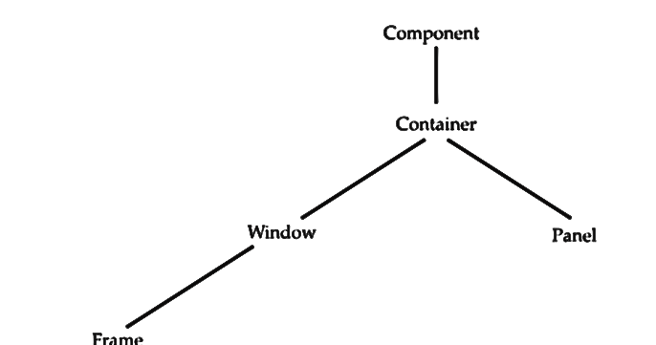

Slide 8
Swing fundamentals
Swing is written entirely in Java (platform-independent).
  So swing components are light-weight
  Swing components are NOT implemented by platform-specific code.
Swing is a set of classes.
Swing is built on the foundation of the AWT(Abstract Window Toolkit).
Swing provides more powerful and flexible functionalities than standard AWT components.
Swing classes are defined in javax.swing package and its subpackages.

Slide 9
Swing Key Features
Two key features of Swing are
  Swing components are Lightweight
  Swing supports a Pluggable Look and Feel

Slide 10
Swing Key Features-Swing components are Lightweight
Swing Components are lightweight because
  they are written entirely in Java
  they do not map directly to platform-specific peers.
    Peer classes are written by java API developers to interface with native objects
  Lightweight components do not call the native operating system for drawing the graphical user interface(GUI) components
  They are rendered using graphics primitives
    they can be transparent, which enables nonrectangular shapes.
  lightweight components are more efficient and more flexible.
Notes:
AWT is heavyweight because its components are dependent on the underlying Operating System .When we create an object of java.awt.Checkbox class, its underlying Operating System will generate a checkbox for us.

Slide 11
Swing Key Features-Swing components are Lightweight(contd.)
Lightweight components
  do not translate into native peers,
  the look and feel of each component is determined by Swing, not by the underlying operating system.
This means that each component will work in a consistent manner across all platforms.

Slide 12
Swing Key Features-Swing Supports a
Pluggable Look and Feel
Swing supports a pluggable look and feel (PLAF).
  Because each Swing component is rendered by Java code not by native peers, the look and feel of a component is under the control of Swing.
It is possible to separate the look and feel of a component from the logic of the component.
  Advantage:
  It is possible to change the way that a component is rendered without affecting any of its other aspects
    it is possible to “plug in” a new look and feel for any given component without creating any side effects in the code that uses that component.

Slide 13
Swing Key Features-Swing Supports a
Pluggable Look and Feel
It is possible to define entire sets of look-and-feels that represent different GUI styles
To use a specific style, its look and feel is simply “plugged in.”
  Once this is done, all components are automatically rendered using that style.
Pluggable look-and-feels offer several important advantages.
  It is possible to define a look and feel that is consistent across all platforms.
  it is possible to create a look and feel that acts like a specific platform.
    For example, if you know that an application will be running only in a Windows environment, it is possible to specify the Windows look and feel.
    It is also possible to design a custom look and feel. Finally, the look and feel can be changed dynamically at run time.

Slide 14
Difference between Swing and AWT
Swing | AWT
Swing components are not platform-dependent. | AWT components are platform-dependent
Swing provides several additional components such as scroll panes, trees etc in addition to other standard components | The AWT defines a basic set of controls, windows, and dialog boxes that support a usable, but limited graphical interface.
Swing is written entirely in Java. So swing components are light-weight | AWT components use native code. So they are heavy weight
Swing supports a pluggable look and feel (PLAF) that can be dynamically changed at run-time depending on environment | In AWT look and feel of each component is fixed and it is difficult to change its look and feel.
Swing follow MVC(Model View controller) | AWT does not follow MVC

Slide 15
Swing
Applet
Swing is light weight Component.
Swing needs main method to execute the program.
Swing follows MVC(Model view Controller).
Swing have its own Layout like most popular Box Layout.
Swing uses for stand alone Applications.
To execute Swing, the browser is not needed.
Applet is heavy weight Component.
Applet does not need main method to execute.
Applet does not follow MVC.
Applet uses AWT Layouts like Flowlayout.
Applet need HTML code for Run.
To execute Applet program we need browsers like Appletviewer, web browser etc.

Slide 16
Swing
Swing is a set of program components for Java programmers that provide the ability to create graphical user interface ( GUI ) components, such as buttons and scroll bars, that are independent of the windowing system for specific operating system .

Slide 17
Reference
Herbert Schildt, Java: The Complete Reference, 8/e, Tata McGraw Hill, 2011.

